Slide 1

ES661: PLANETARY REMOTE SENSING
GROUP 4: SPACE WEATHERING ON AIRLESS BODIES
SECTION 7: SPACE WEATHERING ON THE MOONS OF MARS
SECTION 8: DISCUSSION AND INTEGRATION
SHEFALI KURIL
231230013

Slide 2
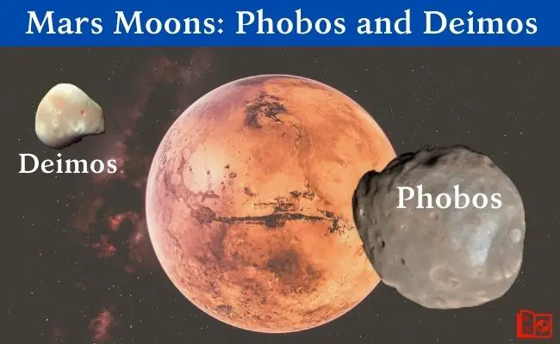

Space Weathering on the Moons of Mars
Phobos is better studied than Deimos, but data is limited in coverage, resolution, and spectral details.
Fig 1: most enigmatic airless bodies
Are these moons captured
asteroids or related to
Mars through debris
accretion?
Limited data on these moons, with more focus on the Mars-facing side of Phobos

Slide 3
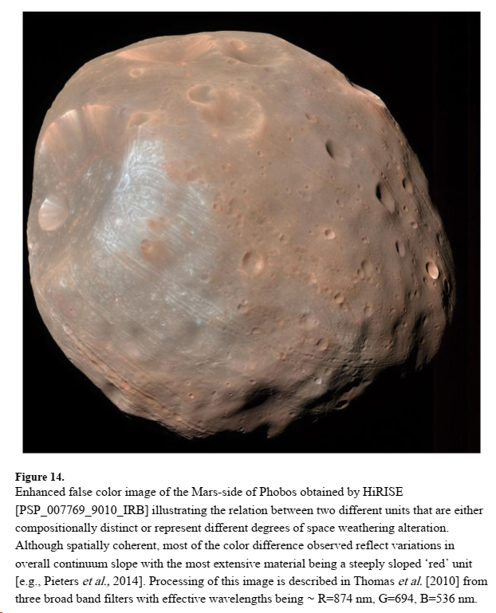
Optical Differences→ material heterogeneities or variations in how regolith (loose surface material) formed and is distributed.
No absorptive features in the visible and near-infrared spectra→ can’t predict the presence of specific minerals or compounds.
While variations in albedo are apparent in visible wavelength images (darker regions with a steep continuum), they appear less distinct in the near-infrared.
Stickney(largest crater)
Possible compositions include dark primitive “D-type” asteroids or highly space-weathered silicate material.
2

Slide 4
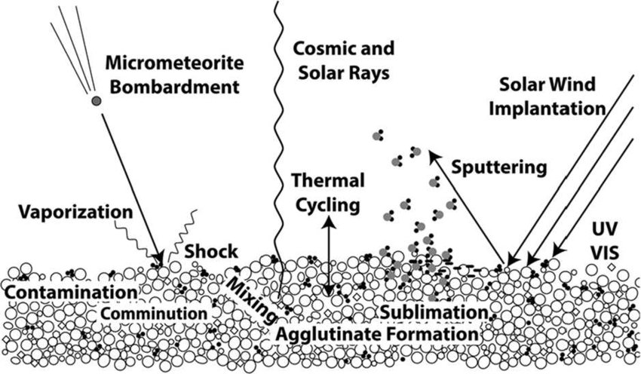
SPACE WEATHERING AND TYPES OF OPAQUE OR ABSORBING PARTICLES
A. Nanophase metallic iron (npFe0) or other nanophase opaque (npOpq) particles= size range of 1-15 nm and accumulate on/in the rims of individual regolith grains imparting a red-sloped continuum in the visible to near-infrared. At low abundances, these particles affect the shorter wavelengths more strongly resulting in a curved continuum.
C. Optically active opaque (OAOpq) particles = npOpq +B-P particles + any group of dark or opaque particles of poorly characterized or undetermined properties.
Fig 3 : various space weathering processes occurring on airless bodies- Research Gate
B. Britt-Pieters (B-P) opaque particles (Fe0, FeS, etc) = size range ∼40 nm to 2 μm (microphase) and are dispersed throughout the matrix of larger particles through impact and friction processes or accumulate in complex glass-welded soil components (agglutinates) produced during repeated small impacts or heating events. Opaque particles of these sizes impose a strongly absorbing (darkening) effect with little or no wavelength dependence.

Slide 5
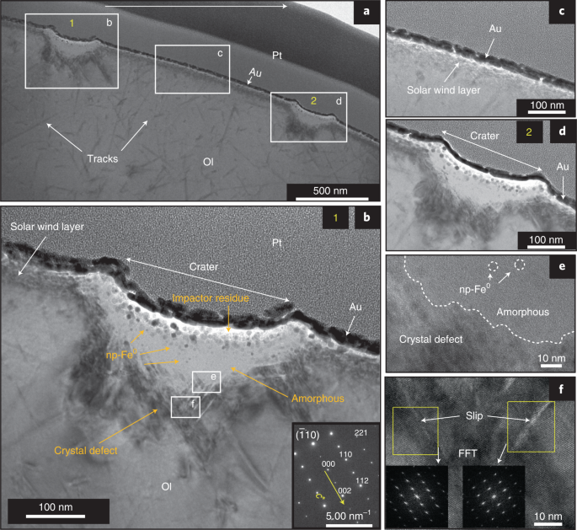
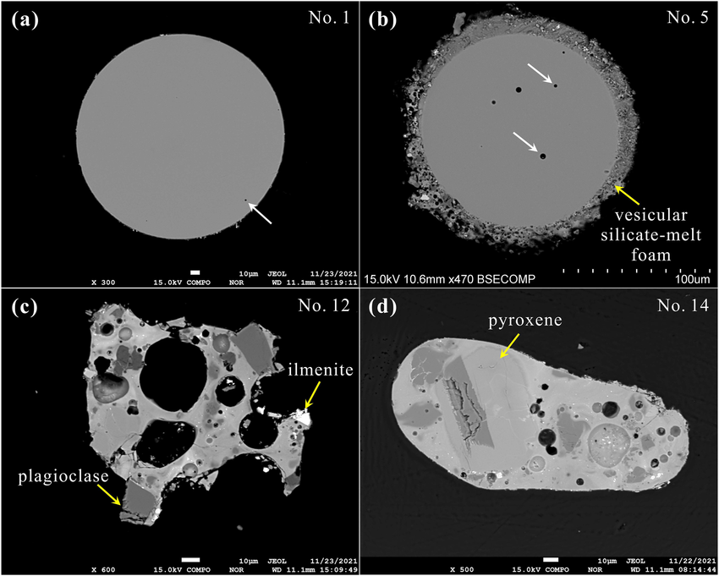
Fig 4:(A):Impact-driven disproportionation origin of
nanophase iron particles in Chang’e-5 lunar soil sample
Fig 5:(C)Micrographs of Chang’E‐5 lunar glass particles.

Slide 6
Many lunar rocks have something called "glass," which is a dense material without a clear structure.
One type of glass, called quench glass, has unique and easily recognizable optical properties.
However, this kind of glass is not commonly found in lunar samples using optical techniques.
Concentrations of quench glass mainly happen as products of quickly cooled volcanic activity, like orange glass 74220 and green glass 15401.
Another more common type of messy dark glass is found in lunar impact melt and breccias. This glass can have various optical properties based on its tiny components, which are often not well understood.
Sometimes, the "glass" can be fully crystalline but at such a small scale that most techniques can't recognize it. In other cases, the amorphous material is a mix of tiny opaque and other particles mixed with small crystalline bits and varying amounts of uncrystallized glass.
While we can measure the bulk chemical properties of this common dark glass, its mineralogy (and, as a result, its optical properties) is unknown.
Untangling the complex composition and history of breccias (rock made of broken fragments) and different types of impact melt is a big challenge for analytical techniques in the future.

Slide 7
CONCLUSION
The ability of regolith to accumulate and retain space weathering products is crucial in understanding the alteration effects of space-weathering processes on planetary surfaces.
Time since surface formation and the size of the celestial body play key roles in the accumulation of regolith and subsequent space weathering effects. Steep slopes may exhibit immature regolith, while flat areas with the same age may show mature regolith.
Lessons from lunar exploration highlight the significance of regolith recycling and its impact on the development of space weathering effects. This knowledge has been applied to other rocky bodies in the solar system composed largely of anhydrous materials.
Understanding space weathering processes on volatile-rich or icy bodies presents challenges, with limited direct observations. The presence of altered hydrous minerals or organic components on dark asteroids and other celestial bodies adds complexity to the study.
Ongoing missions, Hayabusa-2 and OSIRIS-REx which are returning samples from dark asteroids and exploring icy bodies, coupled with sophisticated laboratory experiments, are expected to significantly advance our understanding of space weathering across diverse environmental conditions.
The recognition that cross-contamination among solar system bodies can significantly affect measured surface properties emphasizes the importance of careful interpretation and analysis in space weathering research.
Space-weathering

